Slide 1
Madrid, Spain
By: Sarah Byrd

Slide 2
3.234 Million

Slide 3
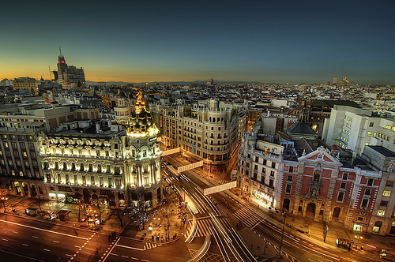
Hotels Meath

Slide 4
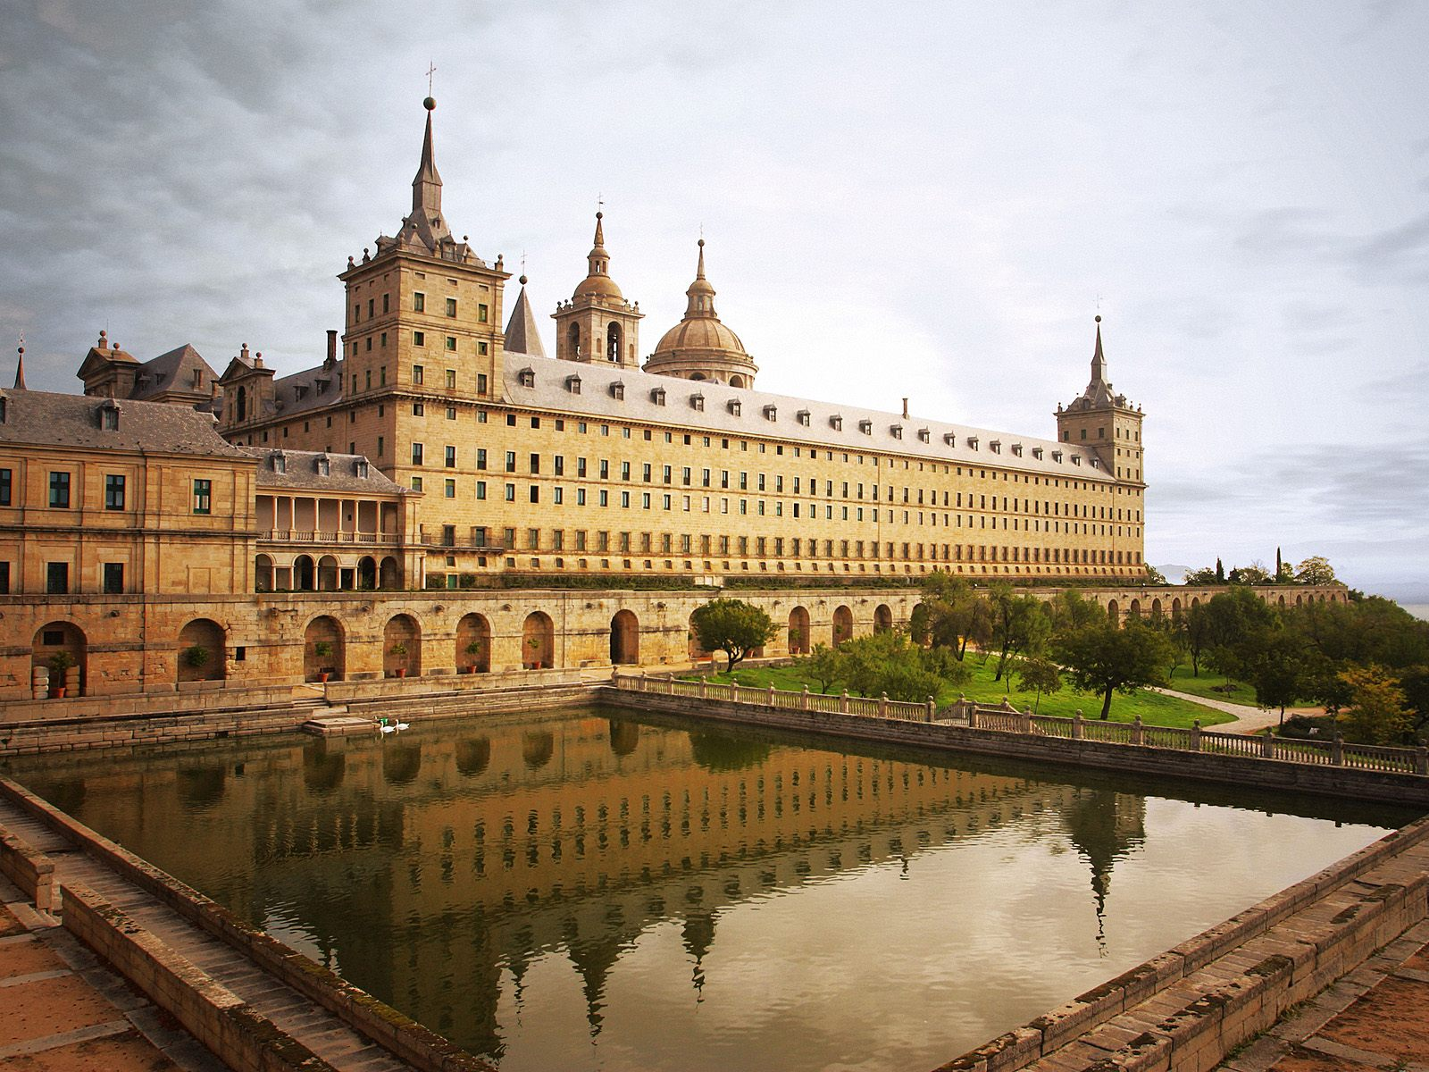
Escorial Monastery

Slide 5
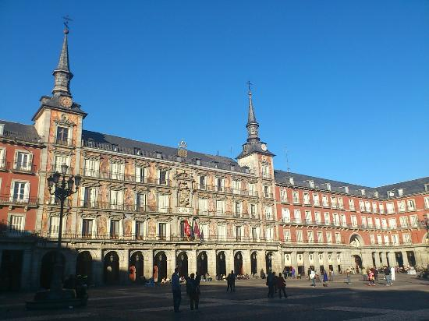
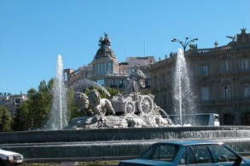
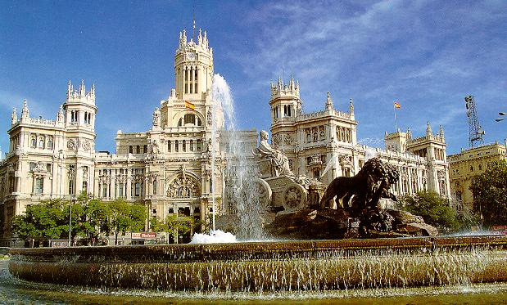
Casa de la Panaderia
Plaza de Cibeles

Slide 6
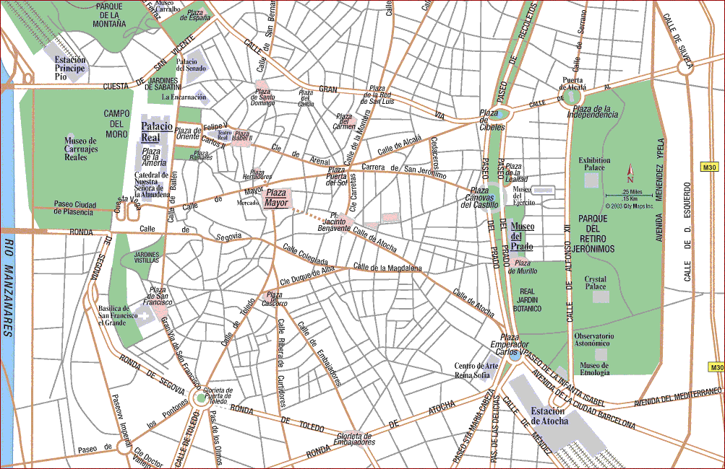
MAP OF MADRID!

Slide 7
Their Safari Park, has over 500 animals
4th richest city in Spain
Like New York, it NEVER sleeps

Slide 8
Credits:
http://www.madridfacts.com/index.php/10-interesting-facts-about-madrid.html.html
http://www.eyeonspain.com/spain-magazine/10-facts-madrid.aspx
Google Images

